Slide 1

HBP Individual Case Study - "Apple Bets on Augmented Reality”
Submitted By – Jayesh Haryani

Slide 2

Introduction
Overview of the current state and Business thinking of Apple
If I was the CIO of Apple
Summary of Approaches
Internal Cultural Challenges and Re-organization of Your Team
Engaging internal customers
Staff Management

Slide 3

Overview of the current state of Apple and its innovative transformative business thinking
Diversification Strategy into AR
AR kit and Third-Party Development
Customer-Centric Approach
Forward-Thinking Vision
Notes:
1. Diversification Strategy into AR
- Recognition of the need to diversify beyond smartphones.
- Emphasis on innovative technologies like AR and wearables.
2. AR kit and Third-Party development
The introduction of ARKit in 2017 reflects Apple's approach to fostering innovation through third-party developers. By providing a software development platform, Apple aims to encourage the creation of a variety of AR applications for its devices.
3. Customer-Centric Approach
Apple's exploration of AR is aligned with the broader trend of tech companies investing in immersive technologies. However, the text raises questions about how AR will generate mass-market appeal beyond certain applications and whether it can replicate the widespread success seen with products like the iPhone.
4. Forward-Thinking Vision
- Anticipation of industry trends and consumer needs.
- Positioning for long-term growth and market leadership.
Closing Message: Apple's transformative business approach ensures adaptability, customer loyalty, and sustained innovation for future success.
Personal Story – Recent launch of Apple AR headset (Apple Vision Pro)

Slide 4

If I were the CIO of Apple
Agile Methodology
Data-Driven Decision Making
Cloud Computing
Cybersecurity Measures
Digital Transformation
Notes:
1. Agile Methodology
Adopt Agile methodologies for software development to enhance flexibility, responsiveness, and iterative development in AR projects.
Promote cross-functional collaboration and frequent feedback loops.
2. Data-Driven Decision Making
Utilize data analytics tools to gain insights into user behavior, preferences, and trends related to AR usage.
Apply data-driven decision-making to enhance AR applications and features.
3. Cloud Computing
Leverage cloud computing services to ensure scalability and efficient storage for the increasing volume of AR content.
Utilize cloud resources for real-time processing and rendering of AR experiences
4. Cybersecurity Measures
Prioritize cybersecurity to protect user data and ensure the secure functioning of AR devices and applications.
Implement robust privacy measures to address concerns related to AR data collection and usage.
5. Digital Transformation
Drive digital transformation with emerging technologies.
Create new revenue streams and improve operational effectiveness.
Closing Message: These strategies create a dynamic, agile, and customer-centric environment, fostering innovation and sustainable growth at Apple.
References from Course – Jim Maholic – Roles of CIO

Slide 5

Start Dates and Timeline
2024
Digital Transformation – Q1 2024
2024
Agile Development – Q2 2024
2024
Data-Driven Decision Making – Q3 2024
2024
Cybersecurity Measures – Q4 2024
2025
Cloud Computing – Q1 2025
Notes:
1. Digital Transformation:
- Start: Q1 2024
- Milestones:
- Assessment and innovation lab setup - Q1 2024
- Pilot AI, machine learning, and IoT - Q2-Q4 2024
2. Agile Development and Rapid Deployment
- Start: Q2 2024
- Milestones:
- Implement agile and DevOps - Q2 2024
- Achieve 20% reduction in development time - Q4 2024
3. Data-Driven Decision Making:
- Start - Q3 2024
- Milestones:
- Enhance analytics and implement BI - Q3-Q4 2024
- Achieve 15% increase in data-driven decisions - Q1 2025
4. Cybersecurity Measures:
- Start: Q4 2024
- Milestones:
- Conduct cybersecurity audit and implement measures - Q4 2024-Q2 2025
5. Cloud Computing:
- Start: Q1 2025
- Milestones:
- Evaluate, select, and migrate to cloud provider - Q1-Q3 2025
- Achieve 50% cloud infrastructure utilization - Q3 2025
Rationale:
- Sequential steps prioritize foundational technology integration, agile practices, data-driven decisions, cybersecurity, and strategic cloud adoption for scalability and collaboration.

Slide 6
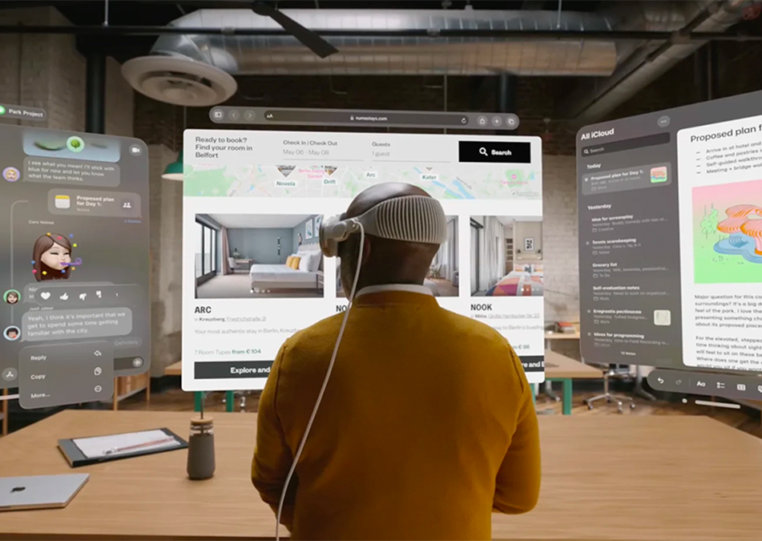
Challenges regarding Internal Teams
Cultural adherence to Tradition
Hierarchical Decision-Making Culture
Employee Empowerment and Engagement
Notes:
Cultural Adherence to Tradition: Employees may resist changes to established workflows, methodologies, and team structures.
Hierarchical Decision-Making Culture: Apple's hierarchical decision-making may hinder the agility required for the proposed support model.
Employee Empowerment and Engagement: Maintaining employee morale and engagement during the transition may be challenging.

Slide 7
Engaging Internal Customers and Business Partners
Stakeholder Engagement
Transparent Communication
Engagement Workshops
Dedicated Support Teams
Notes:
Stakeholder Engagement:
How: Identify key stakeholders through analysis.
With Whom: Collaborate with cross-functional teams.
Approach: Use focus groups and surveys to gather insights, address concerns, and tailor communication plans.
Transparent Communication:
How: Establish clear communication channels.
With Whom: Work with internal communications teams and project managers.
Approach: Utilize town hall meetings, newsletters, and updates for progress sharing and two-way communication.
Engagement Workshops:
How: Organize educational workshops and training sessions.
With Whom: Partner with training teams and subject matter experts.
Approach: Conduct hands-on sessions, webinars, and demonstrations, encouraging questions and interactive discussions.
Dedicated Support Teams:
How: Form dedicated support teams.
With Whom: Collaborate with IT support and help desk personnel.
Approach: Set up support desks, provide clear documentation, FAQs, and ensure teams are well-prepared to assist users with queries and feedback

Slide 8
Staff Management
Skills Assessment and Training
Strategic Hiring
Flexible Workforce
Clear Communication and Change Management
Feedback Mechanism and Recognition
Notes:
Skills Assessment and Training:
Assessment: Evaluate existing skills.
Training: Implement targeted programs for upskilling aligned with the new IT strategy.
Strategic Hiring:
Identify Gaps: Assess critical talent needs.
Recruitment: Hire strategically to fill expertise gaps.
Flexible Workforce:
Contractors/Consultants: Use for specific tasks or short-term projects.
Outsourcing: Consider for non-core functions, aligning with the AR strategy.
Clear Communication and Change Management:
Transparent Communication: Clearly communicate the AR strategy benefits.
Change Management: Develop a plan for a smooth transition, addressing potential resistance.
Feedback Mechanism and Recognition:
Feedback Channels: Establish open communication.
Recognition: Acknowledge and reward contributions to successful AR strategy implementation.

Slide 9

Conclusion
Strategic Workforce Readiness
Investment in Skill Development
Flexibility Through Outsourcing
Performance Accountability
Confidence in Future Success
Notes:
Strategic Workforce Readiness:
Emphasize the importance of strategically preparing the workforce to successfully implement Apple's AR initiatives.
Investment in Skill Development:
Highlight the commitment to employee growth through targeted training programs, development opportunities, and skill enhancement.
Flexibility Through Outsourcing:
Communicate the strategic use of outsourcing and contractual agreements to address specific skill gaps and enhance flexibility.
Performance Accountability:
Stress the establishment of clear performance expectations, fostering a culture of accountability to achieve organizational objectives.
Confidence in Future Success:
Conclude with a positive outlook, expressing confidence in the organization's ability to lead in the dynamic AR industry and create unparalleled value.

Slide 10
Thank You
Any questions?

Slide 11

References
Augmented Reality In Business https://www.apple.com/business/docs/resources/Augmented_Reality_in_Business_Overview_Guide.pdf
Maholic, Jim, and Jud Brandt. It Strategy: A 3-Dimensional Framework to Plan Your Digital Transformation and Deliver Value to Your Enterprise. Jim Maholic, 2019.
Mastering Apple’s AR Guidelines: An Exploration into Designing for AR - https://uxplanet.org/mastering-apples-ar-guidelines-an-exploration-into-designing-for-ar-a8632d84ba6e

Slide 12
Required Case Study Check List
Case Study Items | Yes/No | What slide(s) is your proof of this in your submission? | Proof in your the slide(s) or notes section?
1. Did you review the detailed rubric after you completed this assignment to make sure you covered everything? | Yes | N/A | N/A
2. Did you review all detail/specific and overarching questions in the assignment to make sure you covered everything? | Yes | N/A | N/A
3. Did you do a conclusion slide(s) to answer all required conclusion items/questions? | Yes | 9 | Yes
4. Did you a create reference slide in the proper MLA format? | Yes | 11 | Yes
5. Did you test all your links for references and/or files so a reader can just click to see your materials? | Yes | N/A | N/A
6. Did you proof-read all your slides, attachments, links, notes, etc. before your submission? | Yes | N/A | N/A
7. For your reference slide, did you have internal and external resources/materials to our course? | Yes | 4 | Yes
8. Did you share your own personal stories, thoughts and explain the “Why” your answers are important to you? | Yes | 3 | Yes

